Slide 1
O & G pre-clinical revision session
Nov 16th, 2015
Dr Jessica Braschi, ST7
Derriford Hospital

Slide 2
Amenorrhea
Menorrhagia
Common complications of labour
Hypertension in pregnancy

Slide 3
Amenorrhea (a-meno-rrhea)
Primary amenorrhoea refers to a failure of menstruation:
by the age of 16 years
in the presence of normal secondary sexual characteristics
OR
By the age of 14 years
in the absence of other evidence of puberty
Gonadal quiescence/failure? Reproductive tract anomalies?

Slide 4
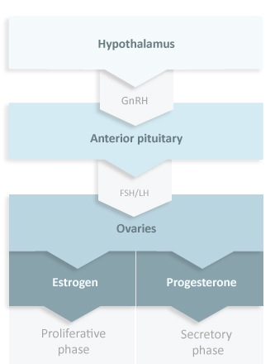

Slide 5
Hypothalamic causes
Primary
Secondary
BMI < 19 or body fat < 22%
Intense exercise (ballerinas, gymnasts…)
Chronic illness; cranial irradiation
Hypogonadotrophic hypogonadism – unknown cause
Craniopharyngiomas and other SOL
Constitutional delay
Kallmans syndrome: rare (1:50 000) congenital absence of GnRH neurons. Associated with anosmia and colour blindness
Long-term risk of osteoporosis. Maximal BD age 25.
  Weight loss
  Exercise
  Chronic illness
  Stress?
  Idiopathic

Slide 6
Pituitary Causes
Primary and Secondary amenorrhea
Prolactinomas: high PRL suppresses the ovaries
Micro or macro
Generally treated medically eg. Bromocriptine, cabergoline
Rare cause of secondary: Sheehan’s syndrome

Slide 7
Ovarian causes
Primary (sometimes secondary if mosaic)
Commonest congenital cause is Turners syndrome (45 X0)
Childhood cancers: some chemo or pelvic irradiation
Secondary
Premature ovarian failure: sometimes autoimmune or infective
Commonest cause (30-40%): PCOS

Slide 8
PCOS
Diagnosis: Two of the three criteria of amenorrhoea, hyperandrogenism or polycystic ovary morphology on USS
(Insulin resistance)
Management:
Lifestyle +++ Weight loss 5-10%
Induce withdrawal bleeds with progesterone to avoid endometrial hyperplasia
Cosmetic treatments or eflornithine cream for hirsutism
Infertility: metformin, clomiphene

Slide 9
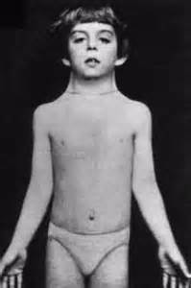
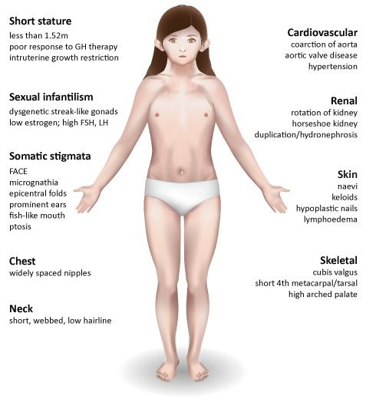

Slide 10
Secondary sexual characteristics present?
  Yes – oestrogen present
  Usually from functioning ovaries –Problem in genital tract
    Eg. Rokitansky – complete failure of utero-vaginal development
    Failure of fusion – longitudinal vaginal septum, absent cervix
    Failure of canalisation eg. Transverse septum
  Can be from peripheral conversion (aromatisation ) of testosterone eg. XY genotype with androgen insensitivity syndrome (undescended testes and female phenotype)

Slide 11
Secondary amenorrhoea is defined as absent periods for at least six months in a woman who has previously had regular periods, or 12 months if she has previously had oligomenorrhoea (bleeds less frequently than six-weekly).

Slide 12
A 16–year-old girl presents with primary amenorrhoea. She has normal external genitalia and normal secondary sexual characteristics appropriate for her age. An ultrasound scan, FSH and LH are normal and karyotyping shows 46XX. Her BMI is 22.
What is the most likely reason for primary amenorrhoea?﻿
Androgen insensitivity syndrome
Familial delayed puberty
Polycystic ovary syndrome
Premature ovarian failure
Turner syndrome

Slide 13
Androgen insensitivity syndrome
Familial delayed puberty
Polycystic ovary syndrome
Premature ovarian failure
Turner syndrome

Slide 14
A 17-year-old girl is brought to the gynaecology clinic by her mother as she has not yet started menstruation. She has a short stature. Blood tests show high FSH and LH. Secondary sexual characteristics have not yet developed.
What is the most likely diagnosis?
Anorexia
Craniopharyngioma
Male karyotype
Rokitansky syndrome
Turner syndrome

Slide 15
Anorexia
Craniopharyngioma
Male karyotype
Rokitansky syndrome
Turner syndrome

Slide 16
A 17-year-old girl attends the adolescent gynaecology clinic with a history of primary amenorrhoea.
She has normal secondary sexual characteristics
She is of average height and normal BMI
Further investigations show normal FSH, LH and estrogen levels.
What is the most likely diagnosis?
Androgen insensitivity syndrome
Congenital adrenal hyperplasia
Kleinfelter syndrome
Rokitansky syndrome
Turner syndrome

Slide 17
Androgen insensitivity syndrome
Congenital adrenal hyperplasia
Kleinfelter syndrome
Rokitansky syndrome
Turner syndrome

Slide 18
Miss EF is referred by her GP. She is 19 years old and has secondary amenorrhoea. Menarche occurred at 13 years followed by regular cycles from about ages 14 to 17 years.
Since then, menses have become increasingly rare and absent for the last nine months. There has been no significant change in BMI and she seemed to stop growing at about 16 years (final height on centile 10).
In childhood, she suffered recurrent otitis media and had grommets inserted aged 7 years. Physical examination is remarkable only for her relatively short stature and she is slightly overweight. Secondary sexual characteristics are present but not fully mature. Pregnancy has been excluded.

Slide 19
Turner syndrome

Slide 20
Alice is 15 years old with secondary amenorrhoea of 12 months' duration. She has been overweight since the age of 7 years and her BMI is now 32 kg/m².
She has had quite severe acne for four years and is taking oral tetracyclines. Recently she has started waxing her upper lip. She is becoming increasingly withdrawn at school and has alleged that she has been bullied and teased about her physical appearance.
Secondary sexual characteristics and growth are within normal limits. She has never been sexually active.

Slide 21
PCOS

Slide 22
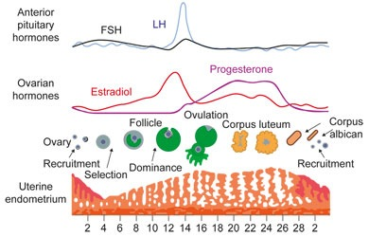
MENORRHAGIA
‘Abnormal uterine bleeding’

Slide 23
Menstrual cycle
Frequency
Duration
Regularity
Volume
Heavy menstrual bleeding:
subjective assessment of MBL combines information of sanitary protection usage, flooding, clots, duration of menstruation and the woman's personal opinion of her menstrual loss.

Slide 24
Overall 3% premenopausal women.
Almost 6% > 40s
Around half have no uterine, endocrine, haematological or infective pathology on investigation – DUB
Pathological causes of HMB include uterine fibroids (20–30%), uterine polyps (5–10%), adenomyosis (5%)
Chronic / acute on chronic presentation (rarely acute)

Slide 25
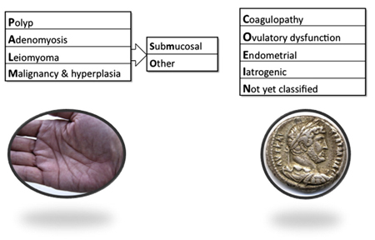
PALM-COEIN:

Slide 26
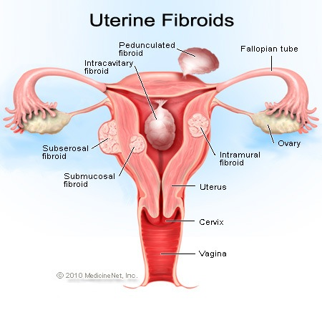
Leiomyoma - fibroids
Submucosal
Intramural
Subserosal

Slide 27
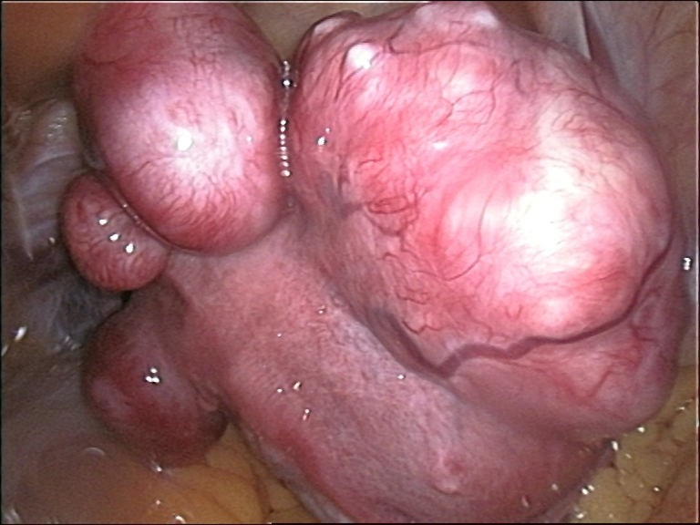
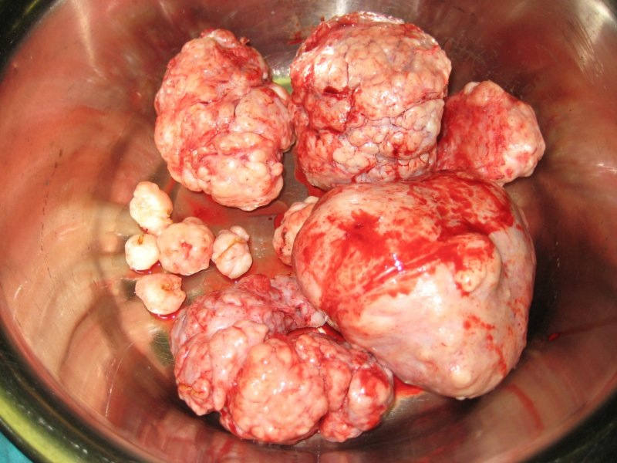

Slide 28
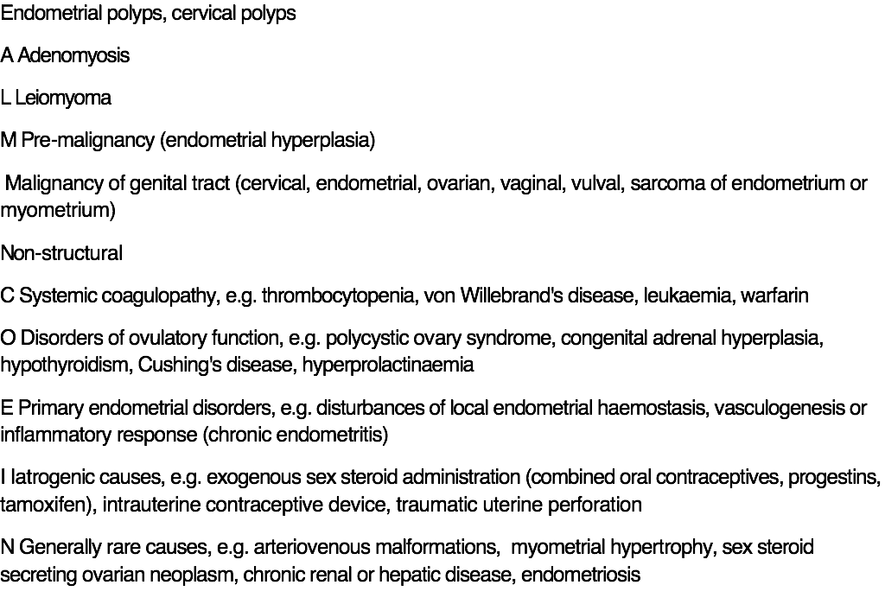
Structural
P | Endometrial polyps, cervical polyps
A | Adenomyosis
L | Leiomyoma
M | Pre-malignancy (endometrial hyperplasia) Malignancy of genital tract (cervical, endometrial, ovarian, vaginal, vulval, sarcoma of endometrium or myometrium)
Non-structural
C | Systemic coagulopathy, e.g. thrombocytopenia, von Willebrand's disease, leukaemia, warfarin
O | Disorders of ovulatory function, e.g. polycystic ovary syndrome, congenital adrenal hyperplasia, hypothyroidism, Cushing's disease, hyperprolactinaemia
E | Primary endometrial disorders, e.g. disturbances of local endometrial haemostasis, vasculogenesis or inflammatory response (chronic endometritis)
I | Iatrogenic causes, e.g. exogenous sex steroid administration (combined oral contraceptives, progestins, tamoxifen), intrauterine contraceptive device, traumatic uterine perforation
N | Generally rare causes, e.g. arteriovenous malformations, myometrial hypertrophy, sex steroid secreting ovarian neoplasm, chronic renal or hepatic disease, endometriosis

Slide 29
Investigations
FBC, smear/swabs, pelvic USS
  GP can initiate treatment
  Hx may indicate need for coagulation screen, TFT.
Hormone profiles rarely useful, unless looking for PCOS or rare testosterone secreting tumours
Pipelle biopsy, Hysteroscopy

Slide 30
Treatment
1st line: COCP, progestogens, Mirena IUS
2nd line: polypectomy, hysteroscopic resections, myomectomy, endometrial ablation, fibroid embolisation
3rd line: hysterectomy
Is preserving fertility important?
Is there any suspicion of malignancy?
Have we excluded pregnancy??

Slide 31
Commonest causes HMB
Simple endometrial hyperplasia
  Secondary to PCOS, obesity, anovulation
Ovulatory dysfunction, often perimenopausal
Fibroids (not in the southwest!)

Slide 32
Common Complications of Labour
Failure to progress
Malpresentation
Fetal distress
Emergencies
  APH
  Cord prolapse
  Shoulder dystocia
  PPH

Slide 33
Failure to progress
3 Ps to consider: Power – Passenger – Passage
Typically primip. Beware if multip!
Primip usually power (contraction) problem – RARELY in multips, esp spont labour
Minimum of 0.5cm cervical dilatation/hour (1cm/hr multips). Also want descent of presenting part.
Correct it with oxytocin infusion.
If still not progressing – obstructed labour
- problem with the passenger (or passage)

Slide 34
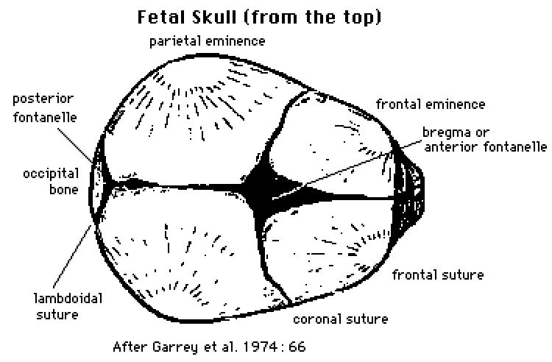
‘passenger’
Malrotation or size

Slide 35
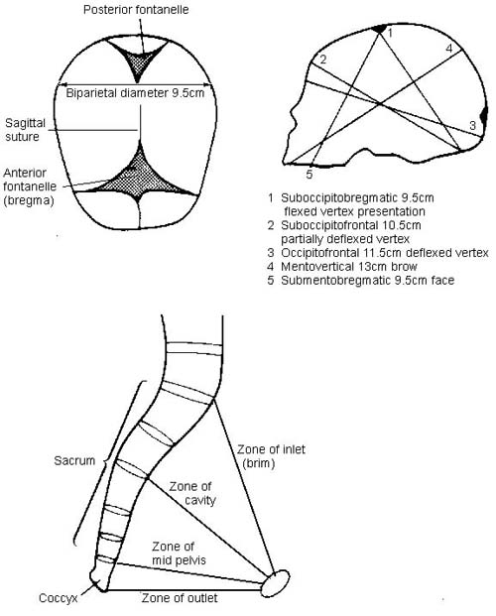
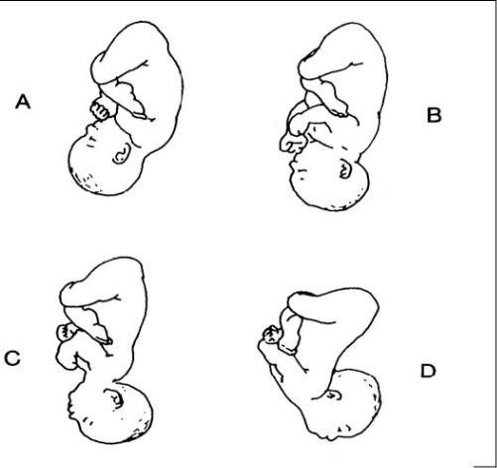

Slide 36
Size (macrosomia)
  Constitutional
  Post-maturity
  Daibetes – pre-existing or gestational
  Rarely fetal anomalies
  ‘Passage’
  Rarely obvious
  Sometimes fibroids obstructing
  LLP
  ?boney structure
  Excess pelvic fat may be one reason why obese women have higher rates FTP

Slide 37
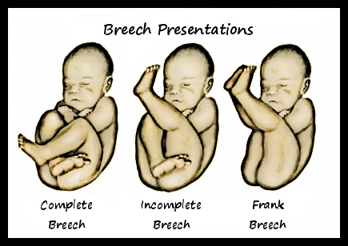
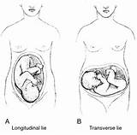
Malpresentation
Cephalic
Breech
Transverse

Slide 38
Breech: ECV? Section? Vaginal delivery?
Transverse: Why?? Placenta? Fibroid?
  Primip??
  Multip
    Section

Slide 39
Fetal distress
Any labour
Risk factors:
  Prematurity
  IUGR
  PET
  Use of oxytocin
  IOL
  Prolonged labour
  Meconium

Slide 40
Ante-Partum Haemorrhage
Placental abruption
Placenta praevia
Vasa praevia
Uterine rupture
Cervical ectropion / polyp
Infection
Trauma
Malignancy

Slide 41
Assessment and management
ABC
Initial resuscitation
Fetal wellbeing
If mother or baby compromised – expedite delivery ( placental location determined first)

Slide 42
Abruption
Typically PV bleeding but can be concealed
Constant abdominal pain
Uterine tenderness
Uterine rigidity
Uterine irritability / contractions
Haemodynamic instability / collapse
DIC
Fetal distress / demise

Slide 43
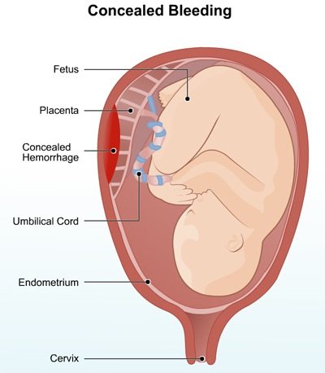
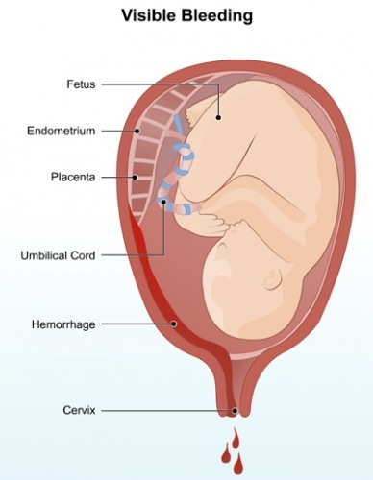

Slide 44
Risk factors for abruption
PHx of abruption
Smoking / cocaine use
Hypertension and pre-eclampsia
Thrombophilia
PROM
Trauma
Evidence of placental dysfunction: FGR, oligohydramnios, abnormal dopplers

Slide 45
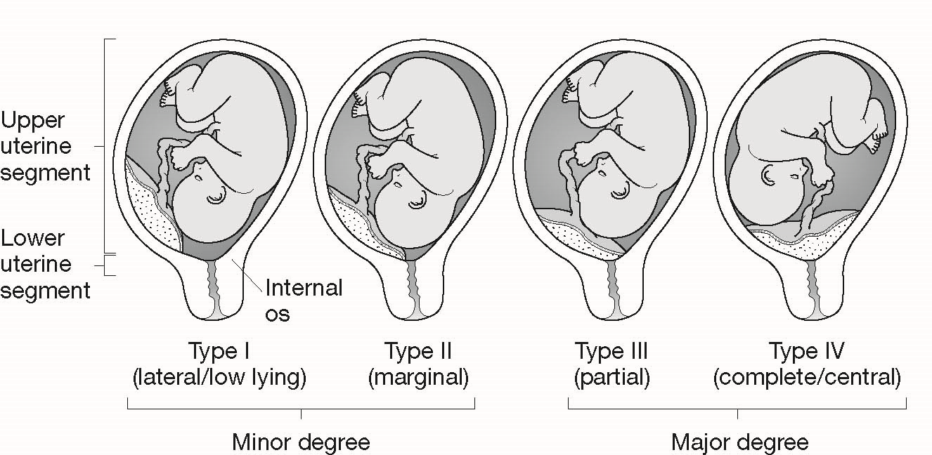
Placenta Praevia (approx. 3% at term)

Slide 46
Risk factors
PHx
Advanced maternal age
Increasing parity
Previous c/section or other uterine surgery

Slide 47
Presentation
Classically painless bleeding
Maternal compromise before fetal
Can be provoked by intercourse or contractions
Anything from spotting to torrential
No concealed bleeding as in abruption
Delivery usually by c/section. NVD may be possible if minor (2-4cm from os)

Slide 48
Vasa praevia
Vasa praevia is defined as fetal vessels crossing the internal cervical os. The major risk is to the fetus when the membranes rupture, whether spontaneously or artificially, as the fetal vessel presenting can tear, thereby causing a fresh antepartum haemorrhage. The blood lost is fetal and not maternal; therefore, a relatively small amount of bleeding can have a devastating effect. The fetal mortality rate for vasa praevia is approximately 60%.
There are two types of vasa praevia:
type 1 occurs secondary to a velamentous cord insertion
type 2 occurs when fetal vessels connect lobes of a placenta, for example when a succenturiate lobe is present.

Slide 49
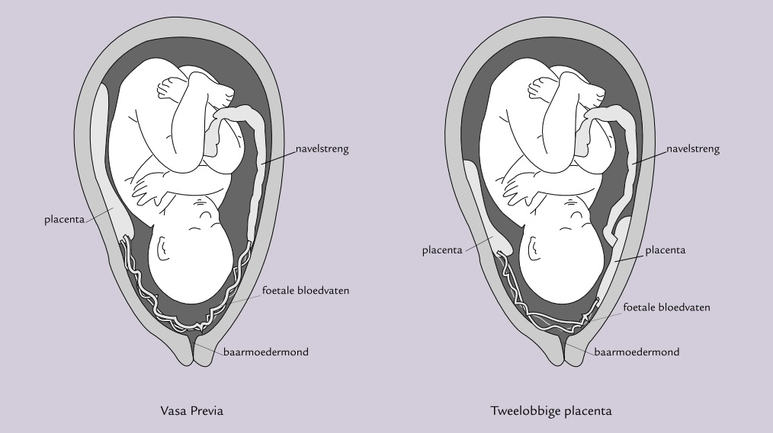

Slide 50
Uterine rupture
Uterine rupture may present with vaginal bleeding. Uterine rupture is full-thickness loss of integrity of the uterine wall and visceral peritoneum. It differs from uterine scar dehiscence in that the former is associated with bleeding, fetal compromise and expulsion of uterine contents into the abdominal cavity. Uterine scar dehiscence does not involve the visceral peritoneum and the placenta and fetus remain in the uterine cavity.
Usually in labour after previous c/section (other uterine surgery eg. Myomectomy. ??unknown uterine perforation at TOP or ERPC)

Slide 51
Cord prolapse
Cord comes out in front of baby through dilated cervix, with ruptured membranes
Risk factors: anything where head not blocking the way!
  Small baby, preterm, malpresentation, high presenting part 2nd twin
  Emergency as cord gets compressed against bony pelvis or cold air causes vessels to constrict – cat 1 c/section
  In mean time, elevate presenting part – knees to chest position, fill bladder, exaggerated left lateral…

Slide 52
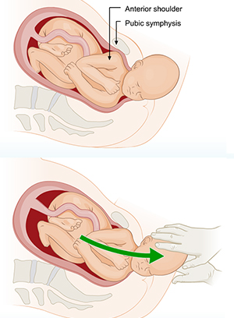
Shoulder dystocia
Impaction of anterior shoulder
behind symphysis pubis
Additional manoeuvres required
0.5-2%
Usually unexpected

Slide 53
Complications
Baby:
Following delivery of the fetal head, the umbilical cord pH drops by 0.04 units per minute ---asphyxia
Brachial plexus injury 4-16%. Only 10% of these permanent
Fractures of clavicle, humerus
Maternal:
Bad tears/lacerations
PPH
Psychological trauma

Slide 54
Risk factors for shoulder dystocia
Antenatal | Intrapartum
Fetal macrosomia | Prolonged first stage
Maternal obesity | Prolonged second stage
Diabetes | Assisted vaginal delivery
Increased maternal age
Previous shoulder dystocia
Post-term pregnancy

Slide 55
HELPERR
H | Help (call for plenty)
E | Evaluate for episiotomy
L | Legs (McRoberts' manoeuvre)
P | Pressure (suprapubic)
E | Enter (rotational manoeuvre)
R | Remove the posterior arm
R | Roll the patient onto her hands and knees
The manoeuvres described are designed to do one or more of the following:
increase the functional size of the bony pelvis
narrow the bisacromial diameter of the fetus
change the position of the bisacromial diameter within the bony pelvis.

Slide 56
PPH
Tone – vast majority
Trauma - tears
Tissue – retained placenta
Thrombin – clotting disorders either pre-existing, iatrogenic or acquired (DIC eg. after APH)

Slide 57
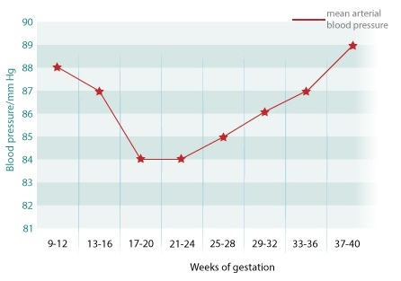
Hypertension in pregnancy
Chronic HTN
Pregnancy-induced hypertension
Pre-eclampsia

Slide 58
Pre-eclampsia
Multi-system disorder occurring after 20/40 gestation
Usually mild if after 36/40
Effects due to widespread endothelial dysfunction
Abnormal placentation modulated by other factors such as genetics, obesity, smoking…

Slide 59
Pre-eclampsia is more common in primigravida women, and the risk of pre-eclampsia increases with an increasing interval between pregnancies.
Risk factors for pre-eclampsia include:
>40 years of age (relative risk [RR]: 1.96; 95% confidence interval [CI]: 1.34–2.87)
previous history of pre-eclampsia (RR: 7.19; 95% CI: 5.85–8.83)
pre-pregnancy obesity (RR: 2.47; 95% CI: 1.66–3.67)
women who become pregnant with donor eggs, embryo donation or donor insemination.
Other risk factors include:
diabetes (RR: 3.56; 95% CI: 2.54–4.99)
pre-existing hypertension (RR: 1.38; 95% CI: 1.01–1.87)
those with a family history of pre-eclampsia (RR: 2.90; 95% CI: 1.704.93)
women suffering from medical conditions such as the anti-phospholipid syndrome (RR: 9.72; 95% CI: 4.34–21.75).
In addition, it appears that particular men are at increased risk of fathering a pre-eclamptic pregnancy.

Slide 60
Presents with:
  HTN 140/90
  Proteinuria (PCR > 30)
  Symptoms: headache, visual disturbance, epigastric pain
  Signs: oedema especially of hands and face, cerebral irritation – jittery, fits, hyperreflexia, clonus
  Small SFH – IUGR, oligohydramnios, abnormal dopplers
  Deranged blood results: low Hb, low platelets, raised urea and creatinine, elevated liver enzymes (transaminases) HELLP

Slide 61
Management
Close observation and monitoring
Control BP (labetalol, nifedipine)
  If mild deliver from 37/40
  Earlier, deliver if
    unable to control blood pressure
    bloods deteriorating
    Severe growth restriction / fetal distress
    Eclampsia
    Other complications

Slide 62
Complications
Eclampsia
CVA
Liver capsule rupture
Renal failure
Clotting disorder and bleeding
Haemolysis
Thromboembolism
Fetal distress / demise

